Slide 1
Executive Visioning Workshop
June 12, 2003

Slide 2
Agenda
Time Description Presenter
7:30 Breakfast
8:00 Welcome Shai Verma
8:10 Introductory Comments Larry Latowsky
8:30 Supply Chain Best Practices David Stevens and Harley Rodin
9:30 McKesson Presentation Doug Wilson
10:00 Break
10:15 Project Casper Supply Chain Vision Rui Martins and Shai Verma
11:15 Change Management Presentation Nancy McTavish
12:00 Lunch
12:45 Metro AG Video Jane Smythe
1:00 Breakout Sessions Al Pinington
1:30 Breakout Session Debrief Lino Casalino
3:15 Break
3:30 Supply Chain Vision Discussion Lino Casalino
5:30 Close Shai Verma

Slide 3
Executive Visioning Participants
Katz Group Canada
Larry Latowsky, President and CEO
Mike Martin, CFO
Terry Buckley, President Herbie’s and CMO
Barry Elliott, President Rexall
Andrew Parkes, President, PharmaPlus
Peter Davidson, VP HR
Grant Schwartz, VP IT
Gersh Sone, VP Pharmacy
Bruce Moody, VP Operations, PharmaPlus
Paul Dale, VP Operations, Herbie’s
Al Wilkie, VP Operations, Rexall
Sue McCabe, VP Private Label
Eugene Gidaro, VP Finance
Chris Taylor, VP Merchandising
Jonathan Alpert, VP Merchandising
Brad Robbins, Chief Marketing Officer
Norm Puhl, Vice Chairman
Paul Marcacio, Katz Group
Rui Martins, Director, Supply Chain
McKesson Canada
Doug Wilson, VP Customer Solutions
Don Nicholson, National Accounts Manager
Graham Hardie, Director Sales Ontario
Jeff Faria, Director Operations Ontario
IBM
David Stevens, BCS Supply Chain Lead Partner
Lino Casalino, BCS Retail Lead Partner
Jane Smythe, BCS Client Relationship Leader
Harley Rodin, Pharma Retail Industry SME
John Woollett, Business Transformation SME
Nancy McTavish, Change Management Lead
Alan Pinington, Supply Chain Lead Consultant
Angelo Cina, Supply Chain Consultant
Shai Verma, Project Manager

Slide 4
Objectives
Provide an executive level awareness of supply chain best practices
Develop a common understanding of the draft Vision to be presented today and a chance to discuss its implications
Discuss the options available to KGC in terms of achieving the Vision
Solicit executive opinions on how to improve the Vision
No decisions are being made today
Your Objectives?

Slide 5
Ground Rules
All players are equal
All ideas are valuable
Start on time, end on time, return from breaks on time
Cell phones and pagers on SILENT
  Phone in the foyer
Minimize side conversations
Minimize trips outside of room
Only one person speaks at a time
Stay in PRESENT TIME
Enjoy
Anything else?
Washrooms:
Exit board room, turn right, exit glass double doors, turn left, exit glass double doors, turn right down hall way, continue about 10 metres:
Females on the left
Males on the right
Emergency Exit:
Exit board room, turn right, exit glass double doors, turn left, exit glass double doors, turn left past elevators on left hand side

Slide 6
Katz Group Canada Business Strategy
Larry Latowsky

Slide 7
Supply Chain Management:
An Overview of eBusiness on Demand in the Supply Chain
David Stevens

Slide 8

Remember the Law of Supply and Demand?
…well, Demand Won!
Notes:
This is an evolution, and yet it's a fundamental shift in the way the best run companies are thinking about:
Allocating precious resources...
Structuring processes...
Competing...
And interacting with partners, employees and customers.
It's a response to a world that's more volatile than ever before.
This isn't just about finding new ways to manage through a weak economy.
On demand modes of operation apply whether the economy is speeding up or slowing down.
In fact, growth can drive as many challenges as a downturn to a supply chain, to customer relationships, or to the resilience of your underlying infrastructure.

Slide 9
The excitement in the Retail Value Chain…
Develop Vision and Strategy
Supply Side
Manage Supply Chain
Manage Products& Services
Manage Brand
Manage Channels
Manage Customer
Manage Relationships
Customer Service
Manage Knowledge
Demand Side
Manage Financials
Manage Information Resources
Manage Human Resources

Slide 10
But, today, YOU will make Supply Chain exciting!
Develop Vision and Strategy
Supply Side
Manage Supply Chain
Manage Products& Services
Manage Brand
Manage Channels
Manage Customer
Manage Relationships
Customer Service
Manage Knowledge
Demand Side
Manage Financials
Manage Information Resources
Manage Human Resources

Slide 11
So, what is the Supply Chain?
  Manage Supply Chain
  Inbound Logistics
  DC Operations
  Reverse Logistics
  Outbound Logistics
  Logistics Vendor Management
  Customer Service
  Manage Products and Services
  Forecasting
  Planning
  Sourcing
  Order Management
  Product Development
  Vendor Management
  Services Development
  Pre/Post Allocate
  Inventory Management
  Cost/Price Management
  Promotions Management
  Replenishment
Develop Vision and Strategy
Supply Side
Manage Supply Chain
Manage Products& Services
Manage Brand
Manage Channels
Manage Customer
Manage Relationships
Customer Service
Manage Knowledge
Demand Side
Manage Financials
Manage Information Resources
Manage Human Resources

Slide 12
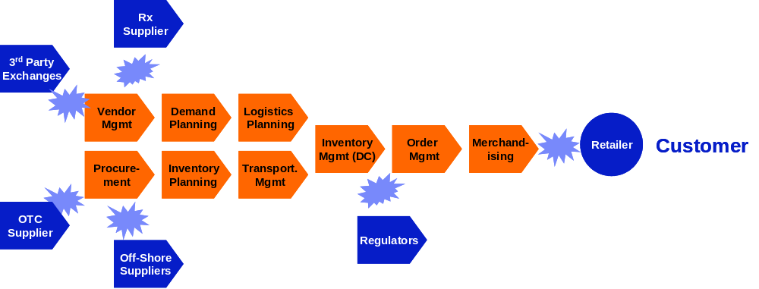
The traditional supply chain friction…
Competition b/w Companies
= Competitive Friction

Slide 13

And, how the supply chain has evolved…
Late 80’s
  Integrated Supply Chain within the ‘Four Walls’
Early 90’s
  Extended Supply Chain linked systems, limited information sharing
Mid 90’s
  ERP linking functions and transactions to the Supply Chain
Late 90’s
  Decision Support Tools, APS linked to ERP
Early 00’s
  Collaborative Supply Chains, Agility focused
Mid – Late 00’s
  Significant Outsourcing Models, Shared Data, eBOD

Slide 14
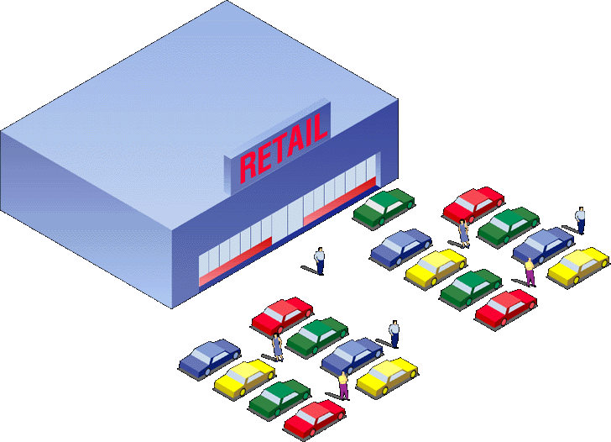


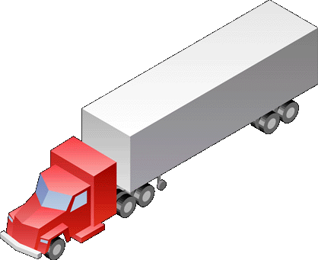
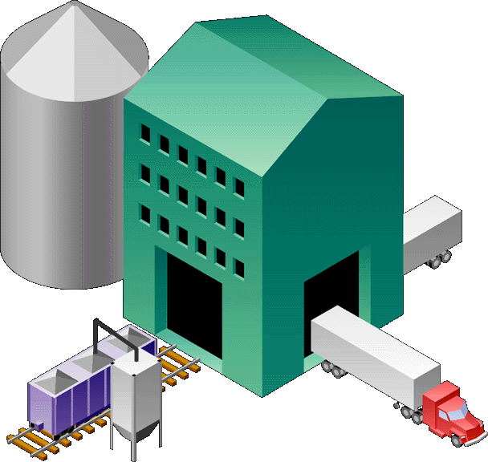
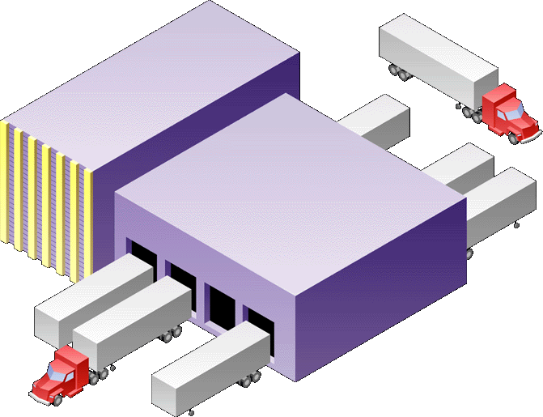



The supply chain in full flight…
From Traditional
Competition b/w Companies
To Agile
Competition b/w Business Models
Rx
Supplier
3rd Party
Exchanges
Vendor
Mgmt
Demand
Planning
Logistics
Planning
Inventory
Mgmt (DC)
Order
Mgmt
Merchand-
ising
Retailer
Customer
Procure-
ment
Inventory
Planning
Transport.
Mgmt
OTC
Supplier
Regulators
Off-Shore
Suppliers

Slide 15

Four trends are changing the value proposition
Responsive:
  Process is being seamlessly embedded between trading partners enabling rapid sense and respond capabilities across the value chain
Variable:
  Technology advances are allowing the entire value chain to become a virtual organization
Focused:
  Managing information effectively is becoming a core competency in effective supply chain management
Resilient:
  Effective supply chain management is strengthening its fiduciary role around managing risk and opportunity

Slide 16
Collaboration is critical to success
Focused
Merchandising
Distribution
Center
Resilient
Transportation
Responsive
MOVE
PLAN
BUY
Responsive
ABC Inc.
Supply Web
Inventory
Management
SELL
Variable
Variable
Rx
Dispensary
eBusiness
Exchanges
Focused
Resilient

Slide 17




Transportation (Variable, Responsive)
Nabisco’s logistics coordination system allows several manufacturers to share transportation costs associated with Lucky Stores deliveries
1
Nabisco uses electronic links to share trucks and warehouses with 25 other manufacturers including Dole and Lea & Perrins
2
Orders are electronically coordinated to meet retailers needs
Suppliers completely fill trucks instead of sending part-empty trailers
3
Albertson’s-owned Lucky Stores cut inventory costs in an 8,000 order test by closely matching orders and deliveries to their consumer’s needs
In addition, Lucky got lower prices on products
4
Notes:
Success Factors
Cooperation among manufacturers
Increased manufacturer-to-manufacturer and retailer-to-manufacturer communication
Deployment of interoperable communication systems for manufacturer, retailer distribution center and stores
Key Results and Metrics
Lower inventory, shipping and handling costs for both manufacturers and retailers
Lucky Stores cut inventory costs by $4.8 million
Manufacturers saved a total of $900,000 while Nabisco saved $78,000 in shipping costs
Fewer trucks needed, reduction of less than load (LTL) shipments
More efficient store operations
Sample Users/Vendors
Users
Albertson’s (Lucky Stores)
Nabisco, Dole
Lea & Perrins,
Capabilities”
Complementary load sharing with complementary/ competitive retailers
Online communication between manufacturer and retailer for coordination of logistics strategies
In-transit monitoring with online alerts when conditions fall outside of desired parameters

Slide 18


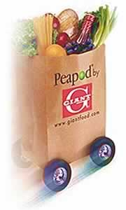






Distribution Centers (Variable, Resilient, Responsive)
Ahold USA’s warehouse network strategy includes a centralized facility (owned and operated by a third party) that supplies all of their 1,100 stores in the Eastern US
Philadelphia, PA
Products will be pre-sorted for each retail outlet at the centralized distribution center
1
Existing centers will be used for cross-docking of perishables
NY, NJ, CT, RI, MA
NY, PA, OH
2
Completed shipments will then be routed to area stores
DC, MD, DE, NJ, VA
NY, NJ,PA, WV
AL, GA, TN, NC, SC
3
Notes:
AHOLD is leading food provider in US (43B) with brands such as Giant, Tops, Bruno’s and Peapod. Very much east coast based! 45 independent store brands on four continents (70B euros HQ north of Amsterdam.
Ability to cross-dock shipments from central facility with perishable goods at regional centers
Availability of trucks to haul shipments longer distances
Deployment of warehouse management system (WMS) to manage products destined for 1,100 stores
Availability of labor to staff central warehouse facility
Improved efficiency for entire distribution system
Lower prices through centralized buying
Faster turnover in facilities
Regional warehouse specialization
Users
Ahold USA
C&S Wholesale Grocers (potential warehouse owner/partner)
Vendors
No sample vendors

Slide 19




Merchandising (Focused, Variable)
A CPFR pilot launched by Nabisco used the Internet to
coordinate category management opportunities with initially Wegman’s and subsequently a variety of chains
Determined the amount of product the retailer might sell in a quarter
Not consulted on quantity of product fed through the channel
1
old way
Exchange sales forecasts via the Web
Mutually agree on an amount of product to supply the retailer based on current sales data from the point of sale, past purchase patterns, and upcoming promotions
2
new e-way
Notes:
A CPFR pilot launched by Nabisco uses the Internet to
coordinate category management
Adoption of open-standards as well as common operating procedures and policies
Ability to integrate disparate systems
Acceptance of CPFR by leading companies and executives
Sharing of information between supply chain partners
Reduced inventories
Shorter cycle times
Better logistics management and planning
Improved forecast variability
Increased sales
Decreased costs
Users
Kmart, Target, Wal-Mart, Dansk, Sainsbury, Tesco, Procter & Gamble
Vendors
I2 Technologies
Manugistics
Syncra Systems Inc.
Logility

Slide 20









Merchandising (Resilient, Responsive)
UCCnet provides the foundation for internet based data exchange between retailers and suppliers by: providing a standardized product classification system; and defining data transfer protocols and technical architecture requirements for data sharing
Notes:
Collaborative commerce between retailers and suppliers on UCCnet’s trading platform will improve information flow
Participation by a critical mass of competitive packaged goods companies for retailers to have meaningful impact and to achieve anticipated efficiencies
Support of two-way data exchange by trading partners to ensure information synchronization
Integration between the various legacy systems throughout the supply chain must be achieved
Reduce discrepancies between supplier and retailer product information and flow-through
Improve invoice and shipment accuracy
Reduce incidence of invoice deductions due to incorrect shipments
Reduce paper based administration and data entry costs
Users
H.E. Butt1, Procter & Gamble1, SuperValu, Ralston Purina, PepsiCo
Vendors
No sample vendors

Slide 21





Inventory Management (Responsive, Variable, Focused)
The Sports Authority uses CPFR technology to share forecast and sales data with suppliers
1
The Sports Authority notifies its suppliers if products are moving as planned or sales are slower than forecasted
2
CPFR technology analyzes data and alerts category managers to exceptional situations that effect sales or delivery (e.g., the Asics 2050 is selling well – and that they will be out of stock shortly in 30 TSA locations)
Internet
3
TSA confirms issue to Asics via CPFR
4
Asics checks inventory and ships more shoes to TSA
5
Asics adjusts production quotas according to store results
Notes:
The Sports Authority uses CPFR technology to share forecast and results data with suppliers
Open standards for communication between suppliers and retailers
Accepted industry-wide operating procedures and processes to drive critical mass and facilitate adoption
Agreements between trading partners
Increased sales
Increased shipping and fill rates
Organizational streamlining and alignment
Administrative and operational efficiency
Improved cash flow
Ability to minimize in-store stock and warehouse inventory
Reduced inventory carrying costs and shrink
The Sports Authority, Kmart, Levi Strauss, Procter & Gamble, Wal-Mart, Syncra Systems

Slide 22


Inventory Management (Responsive, Variable, Resilient)
3
Upon arrival at the Goods Delivery Gate of the Future Store, the Shipment is passing an RFID portal. A door read message containing the collected items is generated and sent to the RFID Inventory Management System.The cartons are stored in the back room storage area.
1
Item Labeling
Scanning of the product barcode and writing of RFID tag that is applied to the item.
Storage area
Manufacturer Distribution Center
Future Store
FedEx
2
Case Building
Products are packed in a case that is equipped with a RFID-tag. The packing list is dynamically created while packing. Cases are sent to the Future Store using direct delivery.
Packing list is delivered to the Inventory Management system over internet.
5
The empty carton is removed from the RFID Inventrory Management system by carrying it through the Trash Gate
Labeled Item area
4
Store area
Each movement of a carton to/from the store area is reported to RFID Inventory Management system.
Notes:
The Sports Authority uses CPFR technology to share forecast and results data with suppliers
Open standards for communication between suppliers and retailers
Accepted industry-wide operating procedures and processes to drive critical mass and facilitate adoption
Agreements between trading partners
Increased sales
Increased shipping and fill rates
Organizational streamlining and alignment
Administrative and operational efficiency
Improved cash flow
Ability to minimize in-store stock and warehouse inventory
Reduced inventory carrying costs and shrink
The Sports Authority, Kmart, Levi Strauss, Procter & Gamble, Wal-Mart, Syncra Systems

Slide 23

eBusiness Exchanges (WWRE)
Best Buy
Boots Company
CVS Corp
Gap Inc.
H. E. Butt Grocery
Hy-Vee Stores
JCPenney
John Lewis Partnership
Kmart
Longs Drug Stores
Marks & Spencer
RadioShack
Rite Aid Corp
Safeway (US)
Safeway plc (UK)
Sobeys
Supervalu Inc.
Target
Tesco
Toys R Us
Walgreen Co.
The premier integrated worldwide exchange community for retailers and their suppliers. Improving efficiency and lowering costs throughout the supply chain
eProcurement (Product Flow)
Auction
eRFX
Order
Execution
SCV
(Tracking)
Product Design and Development
PD&D
Replenishment
Catalog
Information/Reference Tool
Demand
Aggregation
C P F R®
Business Intelligence
(Information Flow)
Notes:
Hy-Vee grocery stores participates in an exchange run by ICS FoodOne
Commitment from enough manufacturers to make the exchange worthwhile for retailers
Utilization of the exchange by both category and store-managers
Deployment of technology in stores to access and trade in the exchange
Increased time for store managers to spend focusing on core in-store activities
Faster inventory turns
Decreased cycle times
Reduced inventory risk
Lower costs for both manufacturers and retailers
Users
Hy-Vee
Spartan Stores
Associated Grocers
Vendors
Internet Commerce Systems (ICS)

Slide 24
The Decapitalized On Demand Business
From Traditional... to Agile, Responsive, Variable, Focused, Resilient & Customer Driven
“Push”
Focus
BRAND CAPITAL
“Pull”
Focus
Production Focus
HUMAN CAPITAL
Customer
Focus
High
WORKING CAPITAL
Low
High
PHYSICAL
CAPITAL
Low
Outsourced Network

Slide 25

A few observations on what not to do?
Outsource everything (or anything you don’t like)
Let contracts control key processes
Ignore the physical capital
Forget to measure key business and customer metrics
Assume today’s model is tomorrow’s model

Slide 26
Rx Dispensary Leading Practices
Harley Rodin

Slide 27

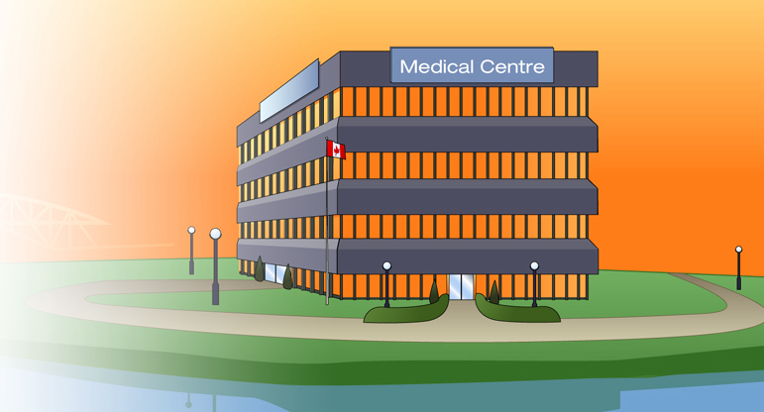


Rx Dispensary: Central Pricing, Care Centre & Claims Switch
Success Factors
Culture shift with store & corporate commitment to central pricing allowing for localization
Platform to provide business services to stores
Leveraging the Rx network to achieve best tax rates, lower carrying costs, monitor the business, improve corporate communications, training, etc.
Fend-off PPOs
Provide for pharmacy program differentiation
1
Current State: Stores with individual price files & routes to adjudicated transactions
Key Results & Metrics
Store level administrative savings
Improved service levels
Consolidated and managed network costs
Consistency of brand image through drug file management
Potential to intervene in Rx filling to substitute alternatives & track cognitive services
Improved inventory and forecasting management
Achieve ROI
2
Best in Class: Centralized Pricing, Shared Services & Claims Adjudication Switch

Slide 28

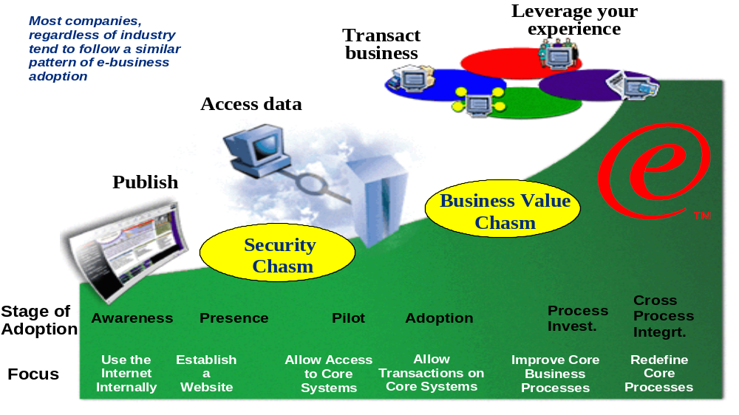
Navigating the -Health Mainstream

Slide 29
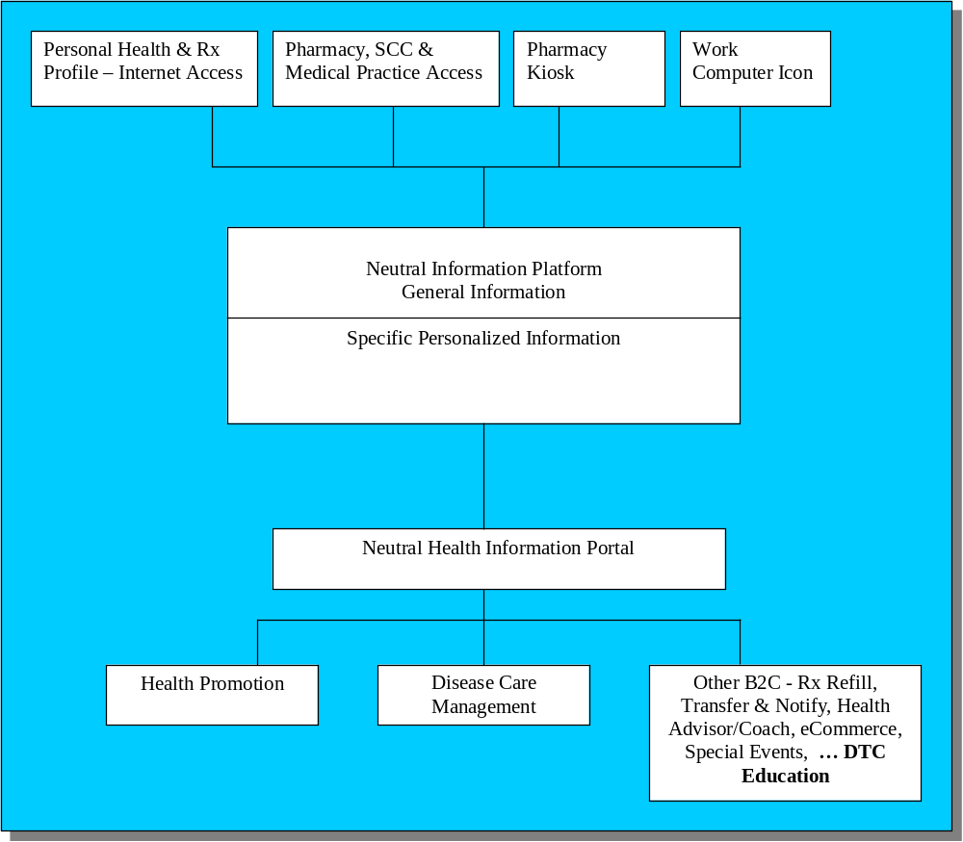
Portal capabilities are emerging in retail pharmacy as a new channel for DTC education and as a trusted resource for consumers

Slide 30
McKesson Executive Visioning Presentation
Doug Wilson, McKesson Canada

Slide 31
Supply Chain Vision
Rui Martins and Shai Verma

Slide 32
Contents
Current Supply Chain and Issues
Recommended Supply Chain and Implications
  Organization, Process, Technology, People
Capabilities that must be Developed
Alternative Paths to Achieving the Vision

Slide 33



Traditional Supply Chain
Wholesale Distributors
Customers
Suppliers
Manufacturers
Retailers
Information Flow
Product Flow

Slide 34

Current KGC Supply Chain
Other Retailers
Manufacturers
E3
TMS
Purchase Orders
KATZ Stores
Customers
WMS
POMS
Store Orders
POS Data
FMS
Suppliers
Invoices
Promotions
McKesson
Information Flow
Product Flow
KATZ HO

Slide 35
Current Organizational Challenges
Complete supply chain is subcontracted to McKesson – not only the physical warehouses, transportation and inventory but also the organizational skills to understand supply chain management.
Planning between KGC and McKesson as it relates to product flow is non-existent.
Performance metrics and targets used by McKesson are not aligned to those of KGC.
Communication across different functional groups within the organization is limited and collaboration with external trading parties is minimal.
  Multiple buyers per vendor contract results in a lack of overall category and contract understanding
Company wide standard operating procedures are limited, not applicable to all banners.
  Corporate wide / Banner wide purchasing and markdown policies do not exist
Currently, McKesson charges KGC approximately $70M annually for the services they provide (~4.9% of cost).
Additionally, McKesson also keeps the trade funds (~$10M annually) they receive from the manufacturers increasing their profit from the KGC account.

Slide 36
Current Process Deficiencies
There is almost no visibility into how McKesson is receiving replenishment orders and how they are fulfilling those orders to the stores. This creates a situation where there is no corporate understanding of what the inventory situation is at any store and therefore, prevents organized attempts to reduce inventory acquisition and carrying costs.
  Retailers live and die by an accurate understanding of their inventory position – KGC has no visibility to inventory at this time.
  During this project, industry-accepted inventory calculations were impossible to make due to the poor practices and data at the store level.
There is no single master file of all products carried in the KGC network. This prevents an organization-wide ability to understand what should be carried, what is carried and the price and profit on each SKU.
  In 2002, over 230,000 UPCs were scanned at the stores but only 50,000 codes are in FMS
Service level metrics are not calculated by KGC – we rely on McKesson’s calculations to assess how well they are meeting our requirements. Based on their calculations, they are fulfilling us at a 95%-98% service level but based on our own calculations, this is actually between 85% and 90%.
  We have subcontracted our supply chain to McKesson but we’ve also given them the responsibility to measure how well they are doing in meeting our requirements.

Slide 37
Current Process Deficiencies (cont.)
KGC is not receiving the benefit of its purchasing volumes and again, have given this benefit directly to McKesson through our contracts with them
  We’ve calculated that the trade funds promotion that McKesson is receiving from manufacturers is as much as $10 million annually.
Currently, KGC performs no demand planning activities and as such, inventory levels are higher than they should be and stock outs are probably greater than expected.
Promotion planning is sub-optimal has its done using manual processes with no integration to procurement and inventory management.
McKesson ships to regional warehouses and performs no trans-loading for KGC
  This means additional procurement costs and up charge rates to KGC

Slide 38
Current Technology Weaknesses
There are a general lack of supply chain management information systems at KGC. This includes no forecasting capabilities, no retail management platform and no inventory management tools.
There is no single, KGC-wide product file and associated pricing information which prevents system-wide pricing and promotions.
Perpetual inventory levels are not available across most stores. Inventories are taken once annually with occasional errors which limits KGC’s ability to be proactive about inventory management. There is no inventory visibility at corporate office.
There is inadequate systems support to perform accurate financial costing and sales analyses. Data is not available in a real-time environment thereby delaying management action on problems.
Point-of-Sale systems are not standardized across KGC. Most functionality is minimal and there is considerable frustration at the store level on their ability to help support store operations.

Slide 39
Current People Implications
Most KGC staff, both at head office and at corporate stores, feel they have poorly defined roles and responsibilities when it comes to supply chain management.
Head office staff do not have the tools to pro-actively monitor the KGC supply chain.
Replenishment of product is left to store personnel who do not have the tools to properly calculate replenishment quantities resulting in overstocks and out of stocks.
Stores have a resource scheduling challenge due to inconsistent product distribution.
There are unique processes by banner that promote silo-behaviour and reduce efficiency.
This silo behaviour results in a lack of accountability for results (i.e. stores purchase inventory for one-time individual discounts vs. corporate stores supporting centralized purchasing through category manager for enterprise-wide cost savings).
The lack of available real-time information for decision-making means that high priced management effort is being spent on non-value-added activities.
Store management time spent reconciling invoices limits their ability to proactively service customers, train, and communicate with staff.

Slide 40
Therefore ……
Based on the executive interviews, store visits, process workshops and quantitative data gathering and analysis, Project Casper has developed the following Supply Chain Vision:

Slide 41
Recommended Supply Chain Vision
A consumer-driven supply chain with collaboration and visibility across all trading partners controlled by Katz Group Canada
Guiding Principles
Build an organization to support supply chain excellence
Create a supply chain that is based on customer pull (demand) enabled by the store network
Provide visibility and control of inventory movement to Head Office
Manage and control the procurement of all products sold through KGC
Develop a single database of KGC product, sourcing and pricing
Provide real-time information when and where required
Leverage trust and collaboration between all trading partners
Understand and execute on the lowest cost to market
Build decision trees with clear responsibilities and accountabilities

Slide 42
Supply Chain Vision

Slide 43

Looking through the supply chain web
Information Flow
Product Flow
Manufacturers
Logistics
Providers
Large
K
Importers
Imports
Small
Ind.
3PL
Distribution
Centres
G
Brokers
C
Traditional
Distributors
Vendors

Slide 44
Katz Supply Chain Vision: Organizational Implications
The supply chain vision incorporates the development of a shared services model responsive to the needs of each of the individual banners. Shared Services will include Finance, HR, IT, Marketing and Merchandising.
The Merchandising group is broken into a Supply side and a Demand side.
The Demand side is responsible for managing the Brand, Channels, Products and Customers: category management, marketing, brand management, selling, content and customer relationship management.
Supply side concentrates on ensuring that stock is available to meet the Demand from customers. Supply side is broken into two distinct sides – Logistics and Supply Chain
Logistics is the physical movement of product. This includes Transportation and Distribution. This role of Logistics is to manage the physical flow of product through the Supply Chain network. The roles include Inbound Logistics, DC Operations, Outbound Logistics, Reverse Logistics, and Appointment Scheduling.
Logistics can be run internally or externally but must be visible and controlled by KGC.
The Supply Chain is involved in all aspects of maximizing the Logistics pipeline. Supply Chain is responsible for Planning, Forecasting, Procurement, Allocation, Replenishment, Inventory Management and Space Management.

Slide 45
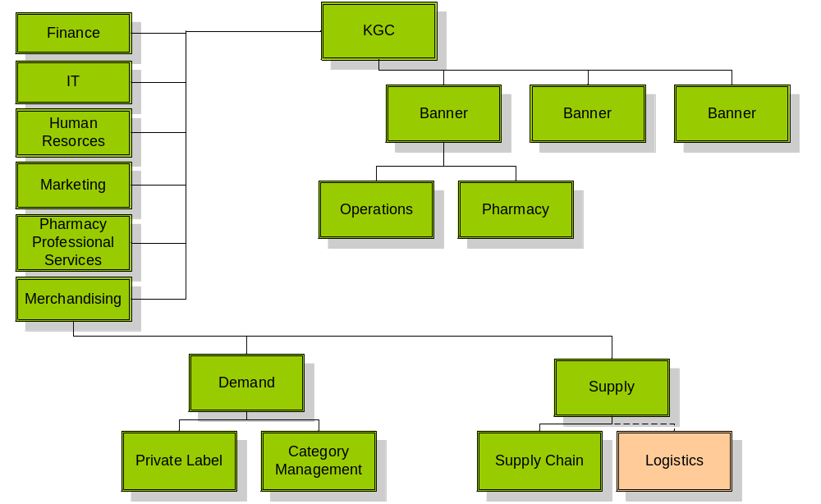
Potential Organizational Chart
Shared Services

Slide 46
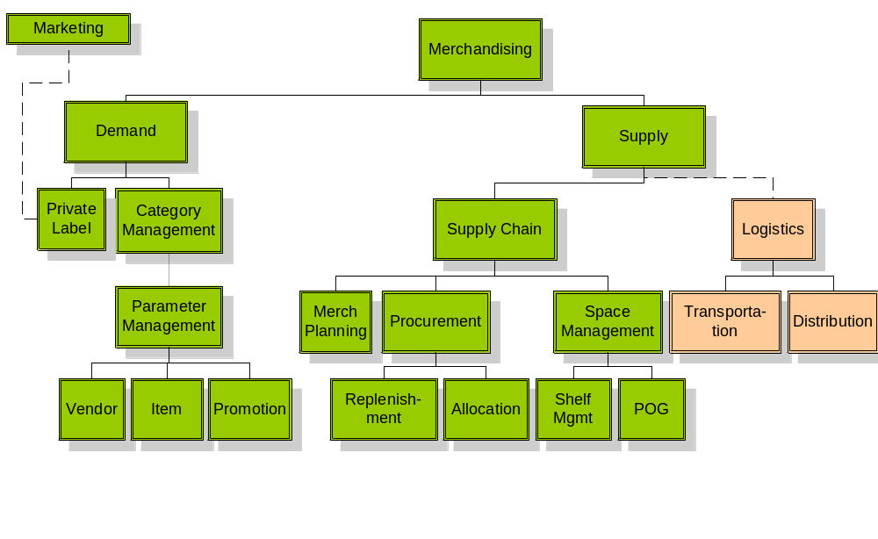
Potential Organizational Chart

Slide 47
Katz Supply Chain Vision: Process Improvements
Plan
Buy
Move
Sell
Merchandise Planning
Replenishment Flow Strategy
Buying Plans
Parameter Mgmt: Item, Promotion, and Vendor Mgmt
Planograms: Space & Floor Planning, Clustering, Shelf Assortment
Item Assortments
Purchase Order Management
Allocation of Orders
Forecasting and Replenishment
Inventory Management
Vendor Managed Inventory
Invoice Matching
Trade Funds Management
Outsourced or Self Provision
Receiving
Transportation Mgmt
Prepare Merchandise
Transfer and Returns
Warehouse Replenishment
Customer Fulfillment
Track Results to Targets
Item and Category Performance
Supplier Performance Metrics
Store-level Receiving, Inventory and Replenishment

Slide 48
Katz Supply Chain Vision: Technology Improvements
Plan
Buy
Move
Sell
Merchandise Planning System
Retail Management System
Collaborative Planning, Forecast & Replenishment
Space Management
Enterprise
Advanced Planning System
Purchase Order Management System
Allocation
Replenishment
EDI , XML ordering
Collaborative Planning, Forecast & Replenishment
Supplier Relationship Management (Vendor Scorecards)
Outsourced or Self Provision
Appointment Scheduling
Replenishment
Transportation Management System
Warehouse Management System
Collaborative Planning, Forecast & Replenishment
Advanced Planning Systems
Point of Sale
Scan-based Trading
Data Warehouse (Reporting)
Intranet/Extranet

Slide 49
Katz Supply Chain Vision: People Considerations
The shared services model will allow for the standardization of processes and performance measurements and will improve KGC’s ability to manage staff across banners.
The clearly defined roles and responsibilities will allow for the creation of standard skills templates, development programs and succession planning. This will prompt the need to establish a training management program.
Store management skills and job activities will be focused on analyzing data and decision-making vs. tactically reacting to conditions.

Slide 50
Supply Chain Capabilities Evolution
Optimize Distribution
Optimize Network
Match
Invoices
Manage Store Labour
Optimize Transport-ation
Manage Purchase Orders
Manage Vendor
Optimize Price
Manage Replenish-ment
Optimize Whse
Plan Store Specific Assort- ment
Manage
Receiving
Manage
Store
Inventory
CPFR
Manage
Promotion
Forecast Demand
Legend
Manage Perpetual Inventory
POS
Manage
Store
Prices
Manage Direct Store Delivery
Business Intelligence
Manage Store Orders
RMS
Manage
Trade
Funds
Manage Item
ERP
Report Financials
Manage GL/AP/AR
Allocate Merchan-dise
APS
EIS
2004
2005
2006

Slide 51
How is KGC Going to Achieve the Vision?
Legend
Low
High
Path | Benefits | Cons | Costs | Time | Risks
Buy | Obtain supply chain skills Can buy only parts that you choose to insource (i.e. front shop) | Integration challenges Potentially acquire more assets than are necessary for KGC business
Build | Potential to create strong internal buy in Custom designed for Katz needs | Internal supply chain skills do not exist
Rent | Focus on core competency Improved flexibility Leverage best practices from 3PL Conservation of capital Leverage economies of scale | Do not have full control Coordination issues Do not gain internal skills Costly in the long term
Mixed Mode | The final approach will consist of a combination of all of these options.

Slide 52
Change Management Implications
Nancy McTavish

Slide 53

Managing the Implications of Change at Katz
Objectives:
Enhance awareness of change implications and challenges of the Casper vision
Prioritize implications for action
“It must be concluded that there is nothing more difficult to carry out, nor more doubtful of success, nor more dangerous to handle, than to initiate a new order of things”
- Machiavelli
Notes:
Now that Rui and Shai have shared with you the vision, we thought it would be helpful to discuss what some of the change implications and challenges would be associated with the various options. Then in order to structure activities for implementation, we would like to gather your thoughts about which implications are of most concern to you.

Slide 54
The Change Readiness Assessment results identified some key issue areas for Katz
Clarity of Direction
Confusion About the Purpose of Change
Leadership not clear about the case for change
Limited sense of what is possible
Unclear direction, confused mandates
Targeted and Effective Communications
Measurements and Rewards
Not Supporting People to Change
Resistance to change and fear of unknown being perpetuated due to lack of a structured communication program
Messages are not currently planned to support people through the transition
A common vision has not been communicated
Lack of Commitment by Established Powers
Team competition and lack of focus on project vision
Inconsistent performance environment
"Silos"—divisional focus of action
Cultural Diversity
Culture Not Aligned with the Change
Values and behavioural norms are not consistent across Katz
Cultural disparity forces socialized behaviour (the way we do things around here)
Not experienced with cross-functional teamwork
Notes:
As part of this initial phase, we conducted a change readiness assessment which included interviewing 11 Katz resources. The purpose of the assessment was to understand and document the scope and magnitude of change and assess Katz’s willingness and ability to implement change.
As a result of analyzing the data collected, findings were clustered into four issue areas. Some of you have not had an opportunity to view these findings. So these issue areas are relevant to share with you now, as they are instigators for the change implications associated with the casper vision.

Slide 55
Change issues and implications are spawned from the transformation necessary to reach a desired state
Organization
Process
Current
State
Change
Management
Desired
State
(Casper Vision)
(Before Implementation)
Information
Technology
Process Redesign Enabled by Technology = Organization People Implications
Notes:
Each of the options associated with the vision involve technology and process changes. Therefore, it is critical to focus on the organization and people impacts because the effect of the implications can ground your business to a halt if not managed effectively. An example of this is a Volleyball game.

Slide 56
There are specific and generic change implications of the various scenarios
Generic
Organization Structure and Jobs
New roles and responsibilities
Job changes
Organization Administration
New policies and procedures across the organization
New performance metrics and measurement process
Competencies
Alignment of skills with vision and strategy
Establish training structure and standards
Buy
Build
Rent
Specific
Cultural alignment
Transition time
Transition effort and performance impacts on new and existing resources
HR infrastructure support (Recruitment, job profiles, skills development, performance management, training)
In-house resource capabilities and availability
Time to acquire or train-up skills and competencies
Capacity to build and move from business as usual quickly
HR infrastructure Support (Recruitment, job profiles, skills development, performance management, training)
Vendor Relationship Management
Project management capability and management of service level agreements
Procurement support
Strategy for knowledge transfer and resource acquisition
Control over performance measurements
Notes:
Let’s look at the various options in terms of specific and generic implications.
The generic implications would apply to any of the options, and it means that new roles and responsibilities will need to be defined and communicated, and changes will need to be made to existing jobs, regardless of the option. In addition, resources and structure will be required to develop and communicate new policies and procedures, and performance metrics and measurements will need to be developed to align with the new processes. In order to reduce the impact on performance, new competencies and skills will need to be identified and assessed against the current, in order to tailor the design and delivery of specific training modules and build a program that will embrace the new desired environment and build a professional development structure for on-going learning and development. Are there any other generic implications you feel should be part of this list?
Let’s talk now about the specific implications of each option.
Option 1 – Build in-house – Far to easy when building in-house to fall back into the old ways of doing things.
Option 2 – Borrow – short term or long term – Vendor relationship management is most important to ensure common goals are being achieved, and that existing Katz resources are not carrying the burden of an under-performing partner.
Option 3 – Buy – capability – You are familiar with the challenges associated with integrating different cultures. There will be a need to determine the desired cultural attributes that meet the new vision, and then determine whether to adopt a new culture, or change the culture of the acquired organization. This can also take time and resources to manage the transition.

Slide 57
Exercise
Prioritize implications into Low, Medium, or High
Low
What implications are not of much concern to you?
Medium
What implications concern you, but do not require immediate attention?
High
What implications are of great concern to you and require immediate attention?

Slide 58
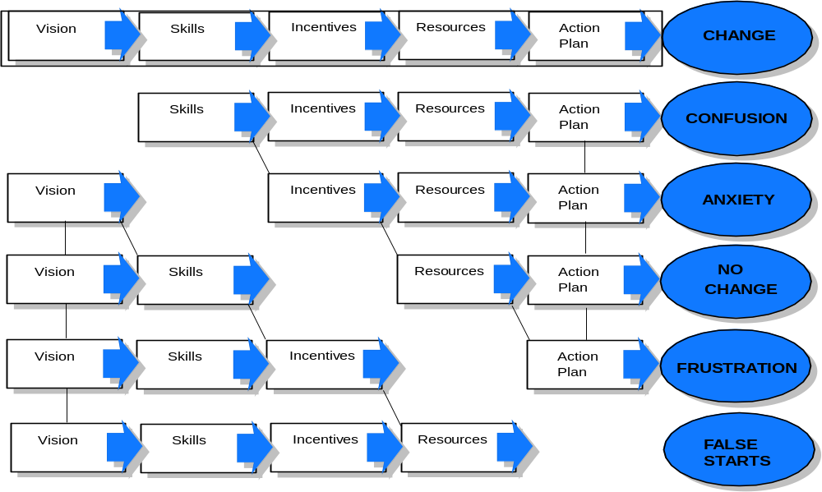
In Summary, Why Do We Need to Manage the Impacts of Change?
Notes:
We need to manage the impacts of change because, regardless of the option chosen, managing the impacts of change means there is a need to effectively address each element.
Establishing a vision, understanding the skill requirements and building them, determining the incentives that will be used to reward desired behaviours, having a resource management plan, and a well planned action plan will ensure successful change.
If any one of these elements are not addressed when implementing the vision, then change will not succeed.

Slide 59
Lunch

Slide 60
Breakout Session
Al Pinington

Slide 61
Breakout Session Agenda
Outline breakout session objectives 5 min
Select spokesperson to present findings 5 min
What do you like about the vision? 25 min
What do you dislike about the vision? 25 min
How can we improve the vision? 25 min
Conclude 5 min

Slide 62
Breakout Session Objectives
Evaluate the proposed supply chain vision
Lay the foundation for how to achieve this vision
Think through the design approach
Identify the key imperatives

Slide 63
Key areas to consider
Business
Processes
Technology
People
Organization

Slide 64
What do you like about the vision?
Organization | Process
People | IT

Slide 65
What do you dislike about the vision?
Organization | Process
People | IT

Slide 66
How can we improve the vision?
Organization | Process
People | IT

Slide 67
Breakout Groups
Group 1 Group 2 Group 3
Larry Latowsky Terry Buckley Mike Martin
Barry Elliott Eugene Gidaro Grant Schwartz
Bruce Moody Andrew Parkes Jonathan Alpert
Sue McCabe Al Wilkie Peter Davidson
Gersh Sone Chris Taylor Paul Dale
Paul Marcacio Brad Robbins
Norm Puhl
Facilitators
Lino Casalino Al Pinington Nancy McTavish
Room
Board Room Across the Hall Downstairs

Slide 68
Conclusions
Lino Casalino and Shai Verma

Slide 69
Recommended Supply Chain Vision
A consumer-driven supply chain with collaboration and visibility across all trading partners controlled by Katz Group Canada
Guiding Principles
Build an organization to support supply chain excellence
Create a supply chain that is based on customer pull (demand) enabled by the store network
Provide visibility and control of inventory movement to Head Office
Manage and control the procurement of all products sold through KGC
Develop a single database of KGC product, sourcing and pricing
Provide real-time information when and where required
Leverage trust and collaboration between all trading partners
Understand and execute on the lowest cost to market
Build decision trees with clear responsibilities and accountabilities

Slide 70
Supply Chain Vision

Slide 71
Looking through the supply chain web
Information Flow
Product Flow
Manufacturers
Logistics
Providers
Large
K
Importers
Imports
Small
Ind.
3PL
Distribution
Centres
G
Brokers
C
Traditional
Distributors
Vendors

Slide 72
How is KGC Going to Achieve the Vision?
Legend
Low
High
Path | Benefits | Cons | Costs | Time | Risks
Buy | Obtain supply chain skills Can buy only parts that you choose to insource (i.e. front shop) | Integration challenges Potentially acquire more assets than are necessary for KGC business
Build | Potential to create strong internal buy in Custom designed for Katz needs | Internal supply chain skills do not exist
Rent | Focus on core competency Improved flexibility Leverage best practices from 3PL Conservation of capital Leverage economies of scale | Do not have full control Coordination issues Do not gain internal skills Costly in the long term
Mixed Mode | The final approach will consist of a combination of all of these options.

Slide 73
Conclusions
The Supply Chain Vision presented today will require a wholesale change in the way KGC operates today.
KGC’s organizational structure will need to change to support the development of a supply chain mindset.
KGC employees’ skills and capabilities need to be significantly developed from where they are now.
The systems and technologies KGC currently uses will need to be enhanced and/or replaced allowing functionality to permit the collaboration and visibility that are the cornerstones of the vision.
Relationships with KGC’s vendors that have been built over the last many years will change radically.
Commitment to the direction needs to be demonstrated from the top and throughout the organization.

Slide 74
Recommended Next Steps
Ensure IT foundations are in place
  A. POS: One system and platform across all corporate stores
  B. RMS: Retail Management System
    Item, Vendor, Promotions
    Retail Financials – Invoice Matching, Trades Funds, etc.
    PO creations, Allocations, Replenishment
  C. ERP: Integrate into RMS for corporate stores
Pursue 3PL opportunity on selected categories
  Front shop product (excludes OTC & Rx)
  Need to renegotiate McKesson contract to lower OTC & Rx up charge costs
  Need to consider implications to Independents
Start building the organizational capabilities required to enabled the Vision
  Hire skilled supply chain professionals
  Identify and mentor existing employees

Slide 75
Thank Your for Your Participation

